Slide 1
Initiation with name of creature of beauties “GOD”

Slide 2
open prostatectomy
Afshar Zomorrodi
professor of urology ,fellowship of kidney transplant ,
Head of organ Transplant ,and urology department

Slide 3
Indications for Open (Simple) Prostatectomy
The indications for either TURP or open (simple) prostatectomy include the following:
Acute urinary retention
Persistent or recurrent urinary tract infections
Significant hemorrhage or recurrent hematuria
Bladder calculi secondary to bladder outlet obstruction
Significant symptoms from bladder outlet obstruction that are not responsive to medical or minimally invasive therapy
Renal insufficiency secondary to chronic bladder outlet obstruction

Slide 4
The advantages of open (simple) prostatectomy over TURP include the complete removal of the prostatic adenoma under direct visualization in the suprapubic and retropubic approaches. However, these procedures do not obviate the need for further prostate cancer surveillance because the posterior zone of the prostate remains as a potential source of carcinoma formation.

Slide 5
Advantages of retropubic prostatectomy
Advantages of the retropubic technique over the suprapubic approach include the following:
Superb anatomic prostatic exposure
Direct visualization of the adenoma during enucleation to ensure complete removal
Precise division of the prostatic urethra, optimizing preservation of urinary continence
Direct visualization of the prostatic fossa after enucleation for hemorrhage control
Minimal to no surgical trauma to the bladder

Slide 6
Advantages of suprapubic prostatectomy
The major advantage of the suprapubic approach over the retropubic approach is that it permits better visualization of the bladder neck and ureteral orifices and is therefore better suited for patients with the following conditions:
Enlarged, protuberant, median prostatic lobe
Concomitant symptomatic bladder diverticulum
Large bladder calculus
Obesity (to a degree that makes access to the retropubic space more difficult)

Slide 7
Advantages of simple perineal prostatectomy
Advantages of perineal prostatectomy include the following:
Ability to treat clinically significant prostatic abscess and prostatic cysts
Less postoperative pain
Ability to avoid the retropubic space
With regard to the last point, above, retropubic or suprapubic surgery is more difficult in patients who have had prior retropubic surgery.

Slide 8
Contraindications to Open (Simple) Prostatectomy
Open (simple) prostatectomy is contraindicated in the presence of prostate cancer. If cancer is suspected, a formal prostate biopsy should be performed before surgery is considered.

Slide 9
The perineal approach can be contraindicated in patients in whom sexual potency remains important. In this procedure, the perineal neurovascular anatomy is invaded more extensively than it is in the other available open techniques.

Slide 10
If cystoscopy findings indicate that the obstructing adenoma primarily involves the median lobe, the suprapubic approach may be preferred to the retropubic technique, because the suprapubic procedure optimizes anatomic exposure.
In addition, retropubic prostatectomy offers only limited access to the bladder, which is an important consideration if a bladder diverticulum requiring excision coexists or if a large bladder calculus must be directly removed.

Slide 11
Disadvantages of open (simple) prostatectomy
Open (simple) prostatectomy does have disadvantages when compared with TURP. These include the morbidity and longer hospitalization associated with the open procedure and the potential for greater intraoperative hemorrhage.
A disadvantage to the use of suprapubic approach relates to reduced visualization of the apical prostatic adenoma and the potential complications of postoperative urinary incontinence and intraoperative bleeding.

Slide 12
The transurethral resection (TUR) syndrome of dilution hyponatremia is unique to TURP and does not occur with open (simple) prostatectomy. The incidence of TUR syndrome during a TURP is roughly 2%. Thus, in patients with a greater risk of congestive heart failure caused by underlying cardiopulmonary disease, open prostatectomy has a much smaller risk of intraoperative fluid challenge.

Slide 13
Consider open (simple) prostatectomy, using either the retropubic or suprapubic approach, when the prostate is larger than 75 g or larger than the surgeon can resect reliably with TURP in 60-90 minutes.

Slide 14
In patients with concomitant bladder pathology (eg, a large or hard bladder calculus, symptomatic bladder diverticulum), additionally, patients with musculoskeletal disease that precludes proper patient positioning in the dorsal lithotomy position for TURP open prostatectomy remains the procedure of choice.

Slide 15
all men should undergo preoperative prostate-specific antigen (PSA) determination and routine digital rectal examination (DRE)

Slide 16
A urinalysis and urine culture, electrolyte study, complete blood count (CBC), coagulation studies,

Slide 17
Discuss potential risks of open (simple) prostatectomy with the patient preoperatively, including urinary incontinence, erectile dysfunction, retrograde ejaculation, urinary tract infection, and the need for a blood transfusion. Additionally, as with all open pelvic procedures, the risk of deep vein thrombosis and pulmonary embolus always exists.

Slide 18
Coincident erectile dysfunction and bladder neck contracture have been reported postoperatively in approximately 2%-3% of patients following suprapubic prostatectomy.

Slide 19
Depending on the degree of preoperative urge incontinence, postoperative urge incontinence may be present for weeks or months.

Slide 20
Retrograde ejaculation has been reported in up to 80%-90% of patients after surgery and is a common phenomenon after these procedures.

Slide 21
Finally, as with any significant pelvic surgery, the risk of nonurologic complications exists, including deep vein thrombosis, pulmonary embolus, myocardial infarction, and cerebral vascular accident. The incidence of these complications, however, is low and reflects the comorbidities of the patient population being treated.

Slide 22
. An estimated 30% of men will require treatment for LUTS, and approximately 20% are likely to undergo surgical treatment Surgical treatment is reserved for refractory cases, as well as cases involving recurrent urinary retention, recurrent urinary tract infection, recurrent haematuria, bladder lithiasis, or upper urinary tract involvement

Slide 23
The RP technique was associated with higher statistical improvement of urinary symptoms, however, it probably does not represent clinical significance

Slide 24
suprapubic prostatectomy refers to the enucleation of adenomatous hyperplastic tissue from the prostate, performed through the cavity of the bladder after extraperitoneal incision of the anterior bladder wall. This may also be termed transvesical prostatectomy to distinguish it from the transcapsular or retropubic prostatectomy. It should be noted that these procedures are not truly prostatectomies and more correctly should be considered adenomectomy, as the true prostate (surgical capsule) is left intact when the operation is properly performed. I suggest partial prostatectomy

Slide 25
CONCLUSION Open transvesical prostatectomy is a safe operation in 30 to 70 g prostates with few complications in comparison with TURP. Open prostatectomy is accompanied by better outcome in relieving obstruction and less dysuria and re-operation. The authors believe that OP can be learned easily and recommend it as a suitable surgical option to be discussed parallel with TURP in patients with 30 to 70 g prostates.

Slide 26
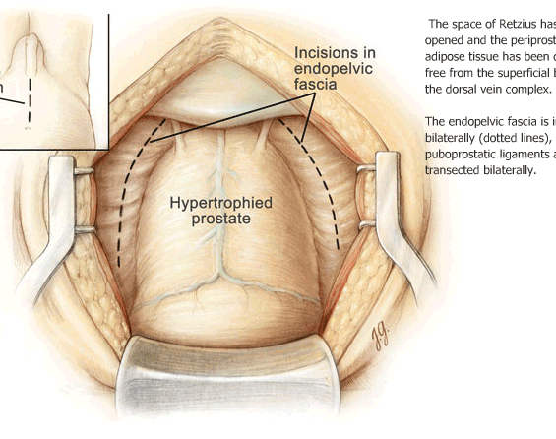

Slide 27
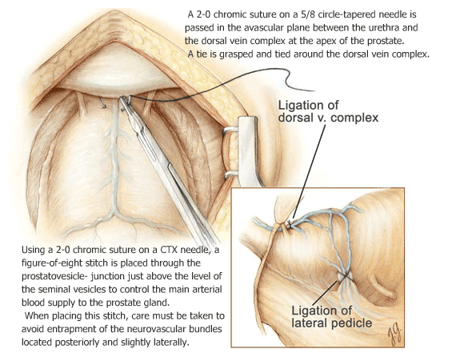

Slide 29
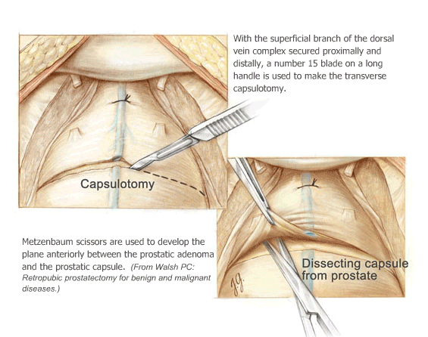

Slide 30
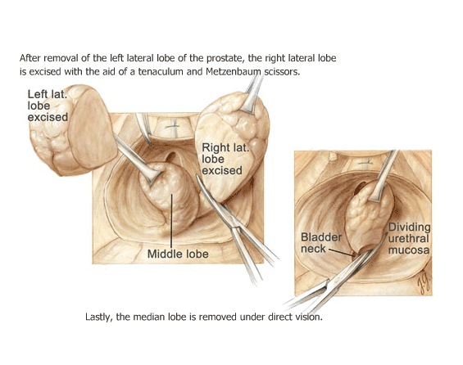

Slide 31
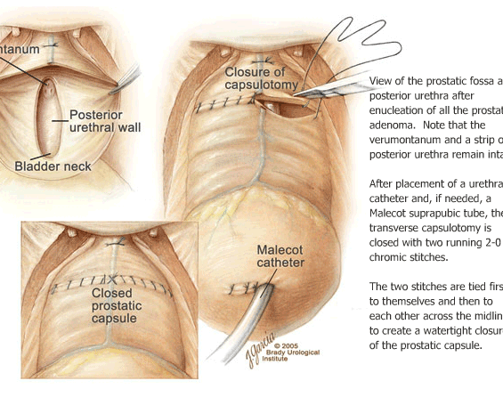

Slide 32
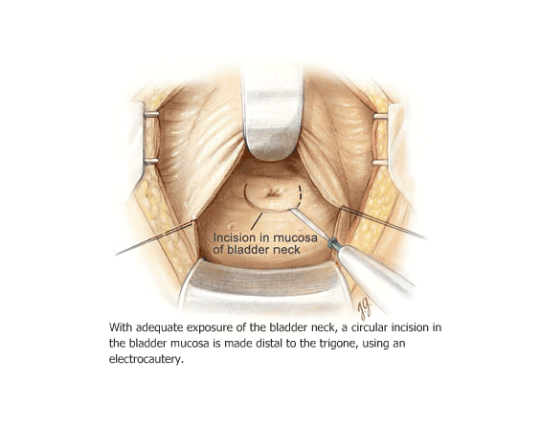

Slide 33
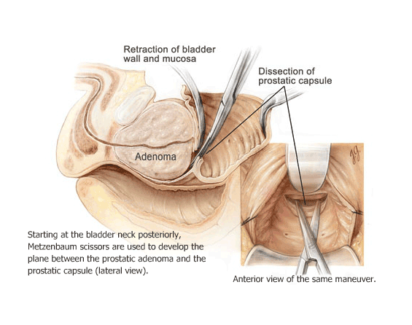

Slide 34
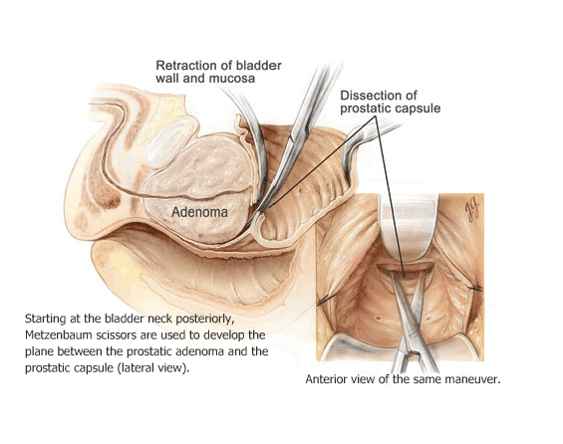

Slide 35
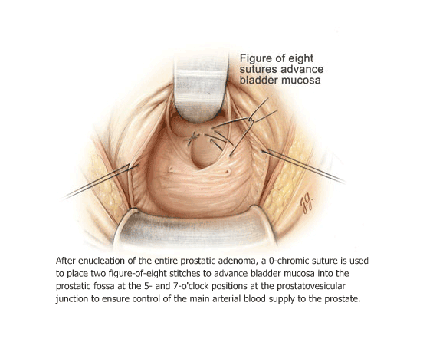

Slide 36
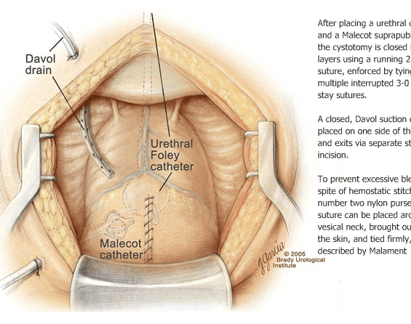

Slide 37
Home massage
1- some kind results of open prostatectomy are better than TUR
2- Retro pubic prostatectomy maybe more effective for caring continence of patient post operation
3- dysuria is more common in TUR because of persisted heated tissue within urethra
4- open surgery less dependent to technology
5- recurrence of adenoma is less with open surgery
6- urothelial tissue is an intelligent and kind tissue more study need for it

Slide 38
Thank you and Have a corona
virus free life

Slide 39
Omnic & VESICARE
VES-2019-0007-IR Sep 2019
Alireza Ebrahiminezhad
Product Specialist
astellas
15 Oct 2020
DISCLAIMER:
The hospital meeting is organized and supported by Astellas

Slide 40
Slide with Sample Agenda
I
Astellas
IV
Star Study
II
OMNIC
V
Administration
III
OAB

Slide 41
astellas

Slide 42
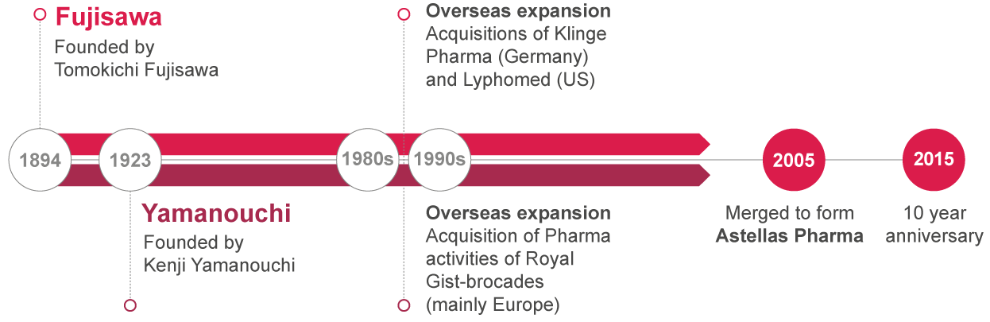

ASTELLAS’ HISTORY AND HERITAGE

Slide 43

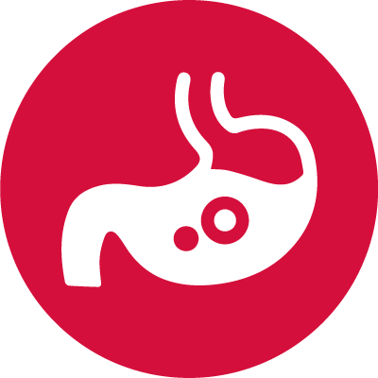

Therapeutic focus
Astellas is committed to turning innovative science into medical solutions that bring value and hope to patients worldwide
Everyday we work to address unmet medical needs with a prioritised focus on the following therapeutic areas:
Anti-infectives
Transplantation
We have been applying our technical expertise and experience to anti-infective agents and are committed to bringing the promise of a brighter tomorrow to this complex area of medicine.
We are proud to have been a supporter of the transplant community for over 20 years as well as supporting transplantation education and awareness efforts.
Oncology
Urology
We are committed to the fight against cancer. We have a number of treatments for various cancers moving through clinical development, with many more in early stage research.
We are leading the way in developing pioneering treatments for lower urinary tract symptoms/benign prostatic hyperplasia (LUTS/BPH), prostate cancer and overactive bladder (OAB).

Slide 44

Changing TOMORROW
Changing tomorrow represents our strong determination to continue our efforts as long as there are people suffering from disease, and to help achieve a brighter future for all patients fighting illness.
In only two words we communicate our main attribute and the primary benefit we bring to all our stakeholders.

Slide 45
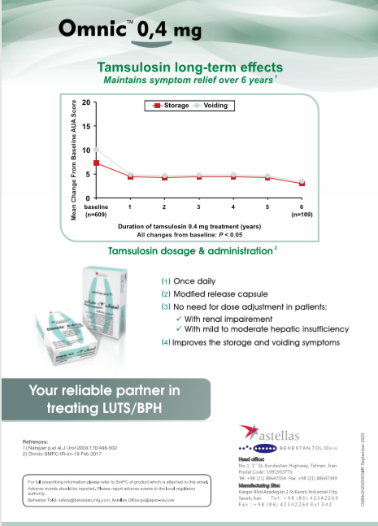

Slide 46
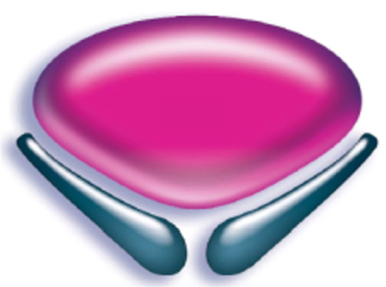
oab
OVERACTIVE BLADDER

Slide 47
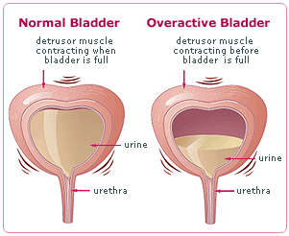
Overactive bladder

Slide 48
The Overactive Bladder Syndrome
OAB is characterized by urinary urgency, and is usually accompanied by frequency and nocturia with or without urgency urinary incontinence (UUI) in the absence of urinary tract infection or other obvious pathology
Pharmacologic management of overactive bladder
Sum Lam and Olga Hilas, Clin Interv Aging. 2007 Sep; 2(3): 337–345

Slide 49
STAR STUDY

Slide 50
STAR Study
Solifenacin in a flexible dose regimen with Tolterodine as an Active comparator in a double-blind, double-dummy, Randomised overactive bladder symptom trial
Chapple et al. Eur Urol 2005; 48: 464−470
Tolterodine: https://www.medicines.org.uk/emc/product/3033

Slide 51
STAR Study
Population & Primary endpoint
Landmark European study for Solifenacin
Head-to-head study with Tolterodine ER
Builds on evidence gained from earlier studies
  Phase II and Phase III studies have previously demonstrated the comparable efficacy of Solifenacin versus Tolterodine 2 mg twice-daily
  STAR was the first study to evaluate Solifenacin as used in clinical practice in a head to head trial
Study population - same as for the Phase IIIa studies
  At least 8 micturitions per day
  One or more incontinence or urgency episodes per day
Primary Endpoint: Change in mean number of micturitions per 24 hours (non-inferiority)
Chapple et al. Eur Urol 2005; 48: 464−470.
Tolterodine: https://www.medicines.org.uk/emc/product/3033

Slide 52
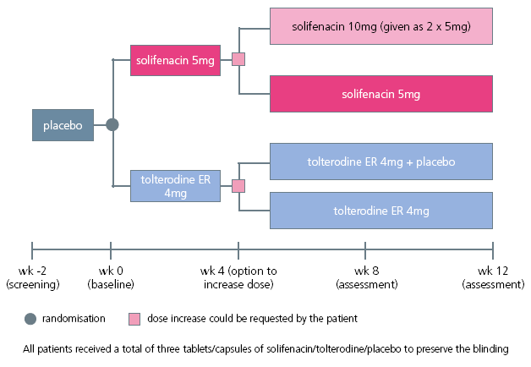
STAR study- Design
Chapple et al. Eur Urol 2005; 48: 464−470.
Tolterodine: https://www.medicines.org.uk/emc/product/3033

Slide 53
STAR Study – Dose Flexibility
% patients requesting dose increase
Solifenacin licensed to increase dose
to 10mg
Solifenacin 5mg
48%
Tolterodine ER not licensed for dose increase
Tolterodine 4mg ER
51%
Chapple et al. Eur Urol 2005; 48: 464−470.
Tolterodine: https://www.medicines.org.uk/emc/product/3033

Slide 54
Results: primary and secondary endpoints Summary
Results:
Effect on number of micturitions /24h (primary analysis)
At endpoint of the 12-week study, Solifenacin 5/10mg was at least as effective as Tolterodine ER 4mg (p=0.004, non-inferiority testing)
The mean baseline to endpoint reductions were:
2.45 (Solifenacin) vs 2.24(Tolterodine ER)
Effect on other efficacy variables
Solifenacin 5/10mg was significantly more effective than Tolterodine ER 4mg for the majority of other efficacy analyses
Solifenacin 5/10mg was significantly more effective than Tolterodine ER 4mg in reducing the number of incontinence pads used per 24h
Chapple et al. Eur Urol 2005; 48: 464−470.
Tolterodine: https://www.medicines.org.uk/emc/product/3033

Slide 55
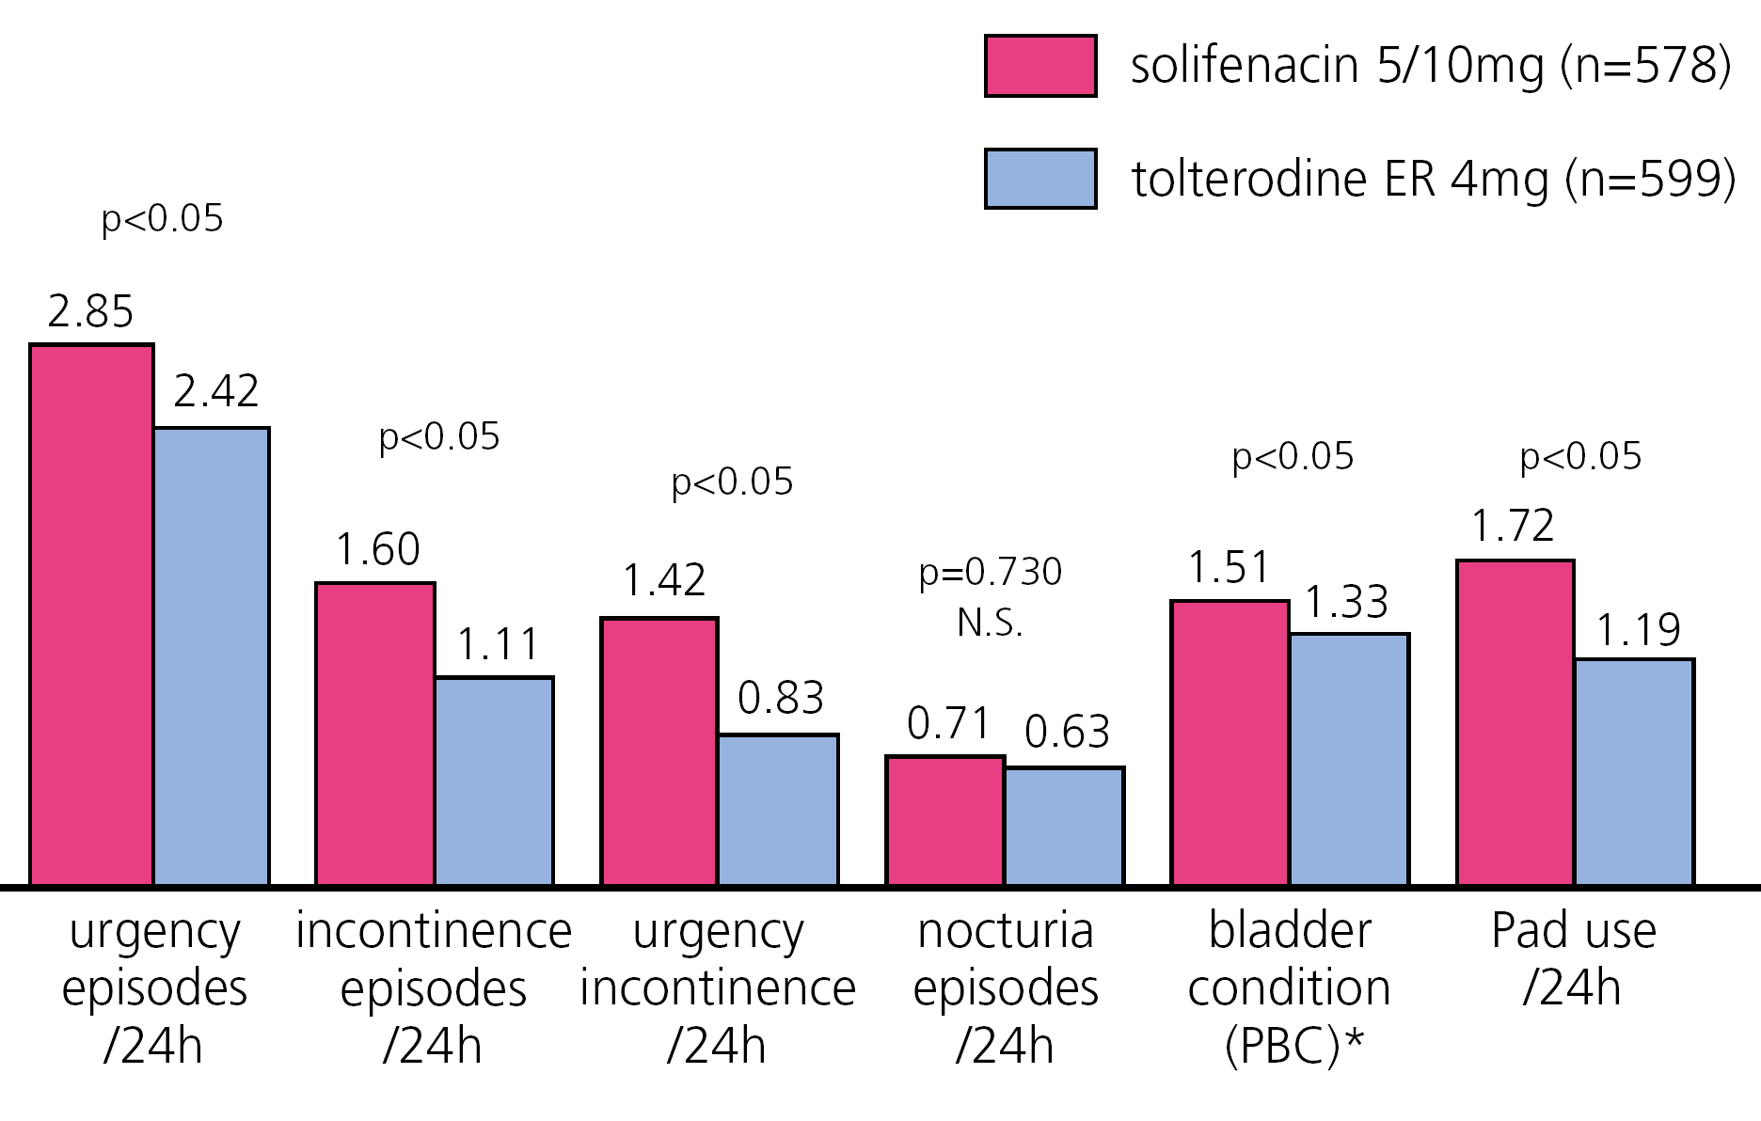
STAR Study – Results Secondary endpoints
Chapple et al. Eur Urol 2005; 48: 464−470.
Tolterodine: https://www.medicines.org.uk/emc/product/3033

Slide 56
STAR study-conclusions
This trial clearly showed that flexible dosing with Solifenacin (5mg and 10mg) is more effective in reducing (key) OAB symptoms compared with the highest available (and recommended) dose of Tolterodine ER 4mg
This included statistically significantly greater reductions in episodes of urgency, urge incontinence and overall incontinence, and a larger proportion of incontinent patients achieving continence by study endpoint
Chapple et al. Eur Urol 2005; 48: 464−470.
Tolterodine: https://www.medicines.org.uk/emc/product/3033

Slide 57
ADMINISTRATION

Slide 58
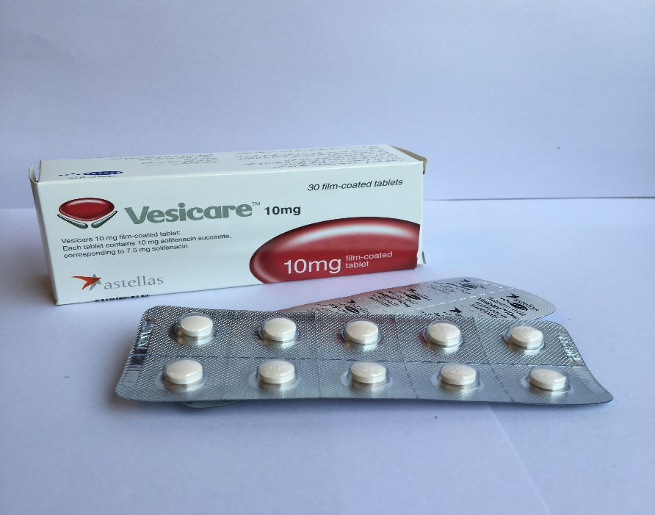
Posology and method of administration - Method of
administration
VESICARE should be taken orally, and should be swallowed whole with liquid
VESICARE can be taken with or without food
Vesicare-SmPC-IR-en-August 2019

Slide 59
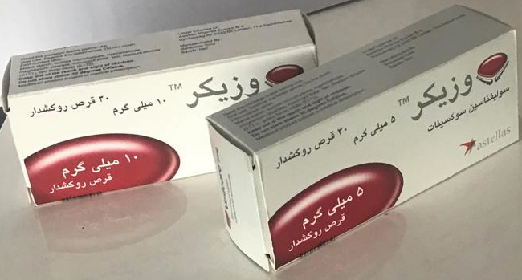
Vesicare-SmPC-IR-en-August 2019

